Slide 1
Blockchain: Architecture & Implementation
Batch 3 Group 1
Cybersecurity Seminar Presentation

Slide 2
What is Blockchain?
The term blockchain was first described back in 1991, in which a group of researchers wanted to create a tool to timestamp digital documents so that they could not be backdated or changed[1].
This technique was adapted and reinvented by Satoshi Nakamoto. In 2008, Nakamoto created the first cryptocurrency, the blockchain-based project called Bitcoin[2].
In general, blockchain technology has the core characteristics of decentralization, accountability, and security.

Slide 3
What is Blockchain?
The traditional architecture of the World Wide Web uses a client-server network. The server keeps all the required information in one place so that it is easy to update, due to the server being a centralized database controlled by a number of administrators with permissions.
In the case of the distributed network of blockchain architecture, each participant within the network maintains, approves, and updates new entries. The system is controlled not only by separate individuals, but by everyone within the blockchain network. Each member ensures that all records and procedures are in order, which results in data validity and security. Thus, parties that do not necessarily trust each other are able to reach a common consensus.
So, the blockchain is a decentralized, distributed ledger of different kinds of transactions arranged into a P2P (peer-to-peer) network. This network consists of many computers, but in a way that the data cannot be altered without the consensus of the whole network.

Slide 4
Core Components of Blockchain Architecture
Node - user or computer within the blockchain architecture (each has an independent copy of the whole blockchain ledger)
Transaction - smallest building block of a blockchain system (records, information, etc.) that serves as the purpose of blockchain
Block - a data structure used for keeping a set of transactions which is distributed to all nodes in the network
Chain - a sequence of blocks in a specific order
Miners - specific nodes which perform the block verification process before adding anything to the blockchain structure
Consensus (consensus protocol) - a set of rules and arrangements to carry out blockchain operations

Slide 5
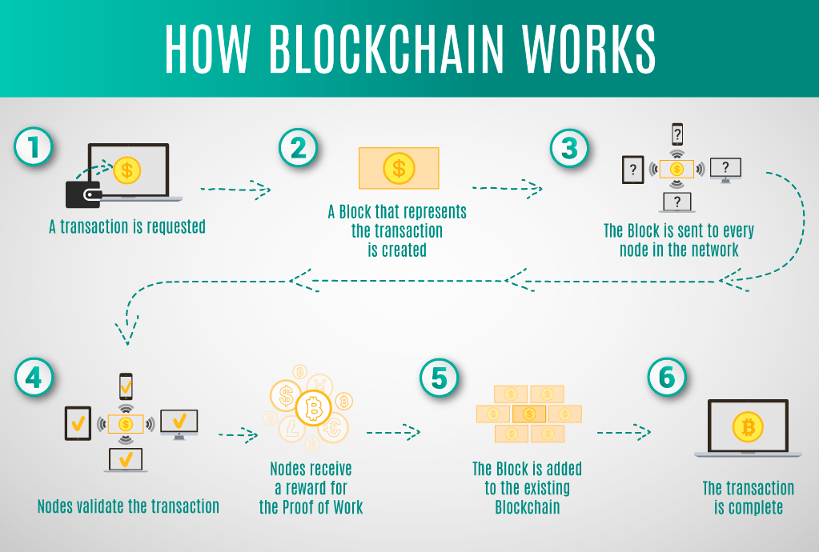
Blockchain system
Any new record or transaction within the blockchain implies the building of a new block. Each record is then proven and digitally signed to ensure its genuineness. Before this block is added to the network, it should be verified by the majority of nodes in the system.

Slide 6
How Blockchain works
Each blockchain block consists of:
certain data
the hash of the block
the hash from the previous block
The data stored inside each block depends on the type of blockchain. For instance, in the Bitcoin blockchain structure, the block maintains data about the receiver, sender, and the amount of coins.
A hash is like a fingerprint (long record consisting of some digits and letters). Each block hash is generated with the help of a cryptographic hash algorithm (say, SHA 256).

Slide 7
How blockchain works
This helps to identify each block in a blockchain structure easily. The moment a block is created, it automatically attaches a hash, while any changes made in a block affect the change of a hash too. Simply stated, hashes help to detect any changes in blocks.
The final element within the block is the hash from a previous block. This creates a chain of blocks and is the main element behind blockchain architecture’s security. As an example, block 10 points to block 11. The very first block in a chain is a bit special - all confirmed and validated blocks are derived from the genesis block.
But what if someone is trying to manipulate this blockchain with false transactions? This is where Proof of Work comes in

Slide 8
Proof of Work
Since any participant can contribute to a public blockchain, consensus is essential for such a distributed network to function, given the potentially thousands of node operators.
A consensus mechanism is the process by which the network reliably and automatically determines which participant’s submitted block—which is a record of recent transactions—will be added to the chain, thus minting and rewarding them with new cryptocurrency in the process.

Slide 9
Proof of Work
Proof of work (PoW) is a form of cryptographic proof in which one party (the prover) proves to others (the verifiers) that a certain amount of a specific computational effort has been expended. Verifiers can subsequently confirm this expenditure with minimal effort on their part.
The computation must be moderately hard (yet feasible) on the prover or requester side but easy to check for the verifier or service provider.
The purpose of proof-of-work algorithms is not proving that certain work was carried out , but instead deterring manipulation of data by establishing large energy and hardware-control requirements to be able to do so.

Slide 10
Bitcoin Proof of Work
The bitcoin proof of work question is simple: What is the string, that when hashed, begins with ‘n’ number of zeroes?
Since hash functions only work one way, you will have to iterate over (on average) 2^n number of strings in order to find the correct string.
This string is then broadcasted to the entire network, and then the network hash this string, and check if it begins with n number of zeroes, and if it is correct, then the block is added to the blockchain.
The person who does this proof is called a miner, and is rewarded for this job with a certain amount of Bitcoin.
This is how a block is added in a blockchain

Slide 11
References
Haber, Stuart; Stornetta, W. Scott (January 1991). "How to time-stamp a digital document". Journal of Cryptology.
Nakamoto, S. (2008) Bitcoin: A Peer-to-Peer Electronic Cash System. https://bitcoin.org/bitcoin.pdf

